Slide 1
Human-Robot Interaction:
Embodiment and embodied cognition
by Dr. Katrin S. Lohan
*Multiple slides over the course adapted form Peter Edward McKenna@HWU

Slide 2
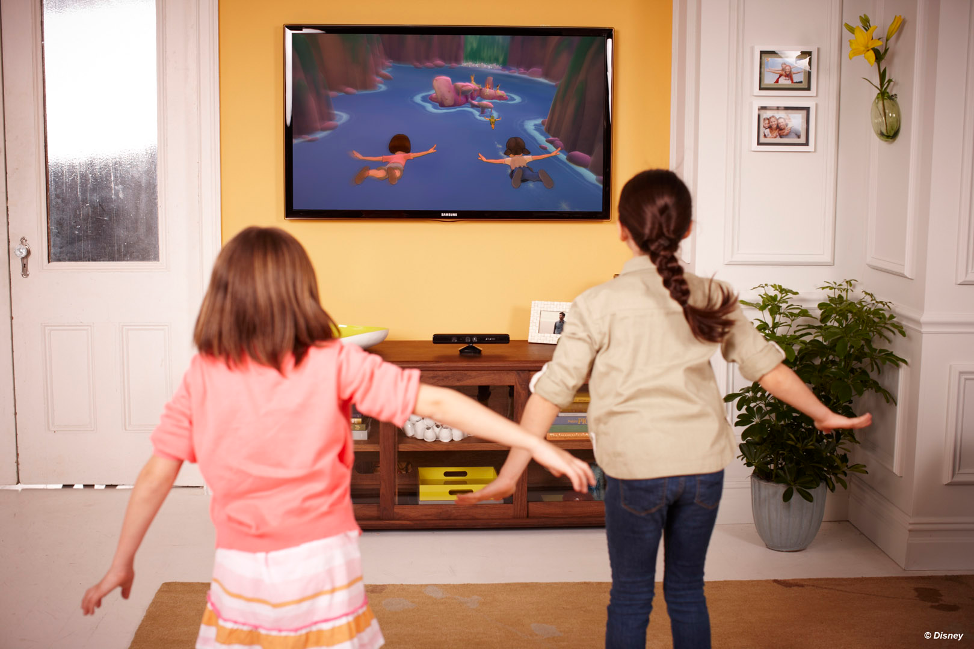


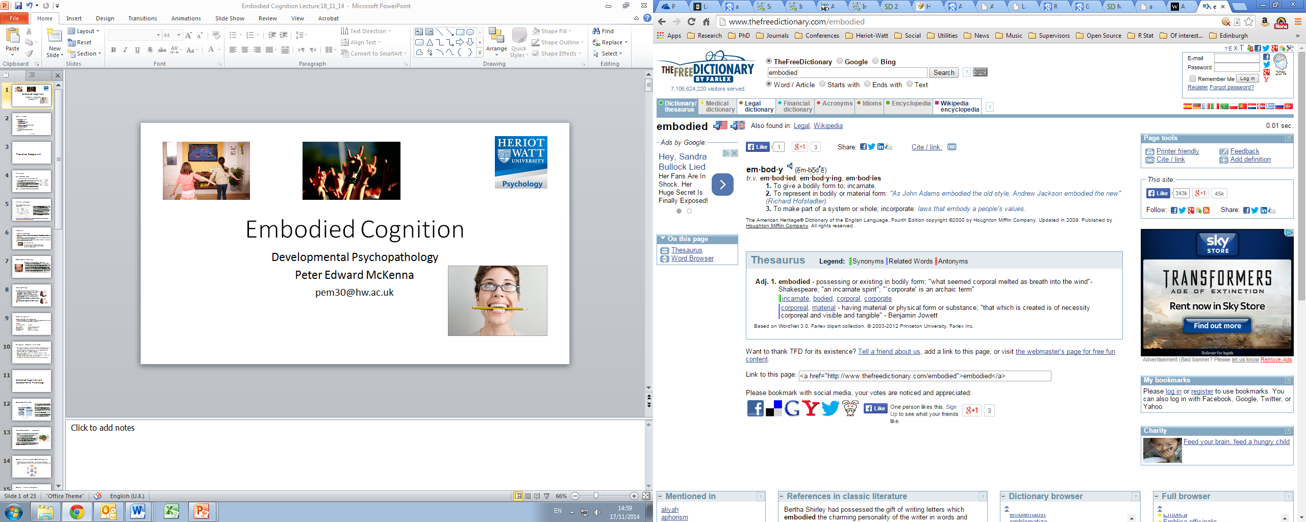
Embodiment and embodied cognition

Slide 3
Lecture Format
Embodied Cognition
Theoretical background
Philosophy
Artificial intelligence
Perception
Developmental Psychology
Neuropsychology
Embodiment
Artificial intelligence

Slide 4


Embodied Cognition
Numeracy
Humour evaluations (Strack et al., 1988)
Definition: The theory that psychological processes are influenced by our body, including sensory input, body morphology, and motor systems (Glenberg, 2010).

Slide 5
Theoretical Background
Embodied Cognition
Developmental Psychology
Artificial Intelligence
Cognitive linguistics
Philosophy
Perception

Slide 6
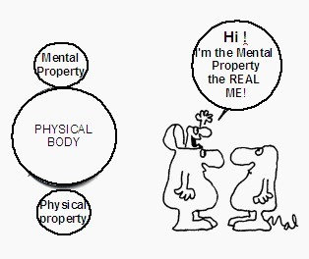
Philosophy
Mind-Body Dualism (Descartes, 1649):
“Cogito ergo sum” trans. “I think therefore I am”
Idea that the mind is immaterial and ‘non-extended’, and the body is a material ‘extended’ entity.
Extended matter (forces that operate outwith the mind, e.g. the body) potentially lead the mind astray. Dualism necessary for the individual’s self-control.
Process of ‘internalism’ allowed mind and body to interact…however Descartes never specified this process fully (Rowlands, 2010).
Theory highlighted the lack of understanding of how the mind communicates with the body, thereby calling into question the body’s role in cognition.

Slide 7
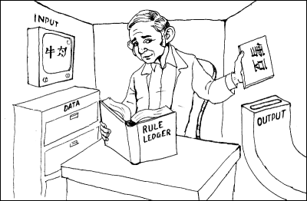
Artificial Intelligence
Searle’s Chinese Room Argument (Searle, 1980)
Searle in a room alone with a manual providing instructions on how to combine Chinese symbols.
Other side of the door Chinese speaker passes notes written in Chinese under the door for Searle to combine.
With the relevant instructions Searle passes to correct response under the door.
To the native Chinese speaker Searle appears to under stand Chinese when in reality all he has done is simple symbol manipulations.
Searle asked the question: Does the human brain process symbols in an analogous manner?
Indicated that human cognition is not simply symbol manipulation – too many potential inputs and outputs (Pylyshyn, 1984).
Symbols do not acquire meaning through formal manipulation.
“While we can readily use computers to manipulate symbolic information, intelligence requires interaction with the world.” (Grafton, 2009, p. 98).
David Mitchell from ‘Peep Show’ gives a great summary on YouTube courtesy of the Open University: https://www.youtube.com/watch?v=TryOC83PH1g
Notes:
Searle’s Chinese room thought experiment is as follows: Searle sits alone in a room with an instruction manual on how to combine Chinese symbols to create sentences. On the other side of the room’s only door is a Chinese speaker who passes notes written in Chinese under the door for Searle to encode. Searle has the relevant instructions to provide a relevant response to the message, and so writes a response and passes it under the door. Thus, to the Chinese speaker on the other side of the door Searle appears to understand Chinese. However, in reality, Searle does not understand a word of Chinese, he simply processes the symbols according to a set of rules (provided in the manual) to produce a relevant output. So, Searle acts like a computer program. It is his duty to operate on symbols by copying them, sorting them into certain arrangements, comparing them, and replacing one symbol for another, in a similar manner to a computer. Searle claimed was that even after performing these different symbol manipulations he would never understand the meaning of these symbol combinations.
Searle’s Chinese thought experiment was influential as it provokes the argument surrounding symbol grounding. It became apparent that in order for a computer to pass what is known as ‘the Turing Test’ – to demonstrate human levels of conversation – more knowledge of the content and type of symbols humans process was needed. It became apparent that perception and sensorimotor action are critical to humans development of cognition, and therefore, and a more embodied interpretation of symbol grounding was more adequate than the symbol processing account.

Slide 8
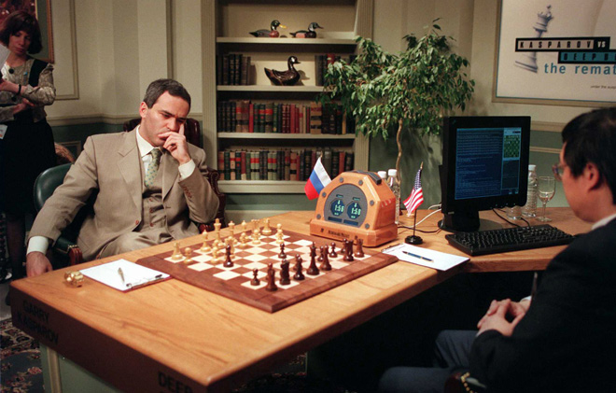
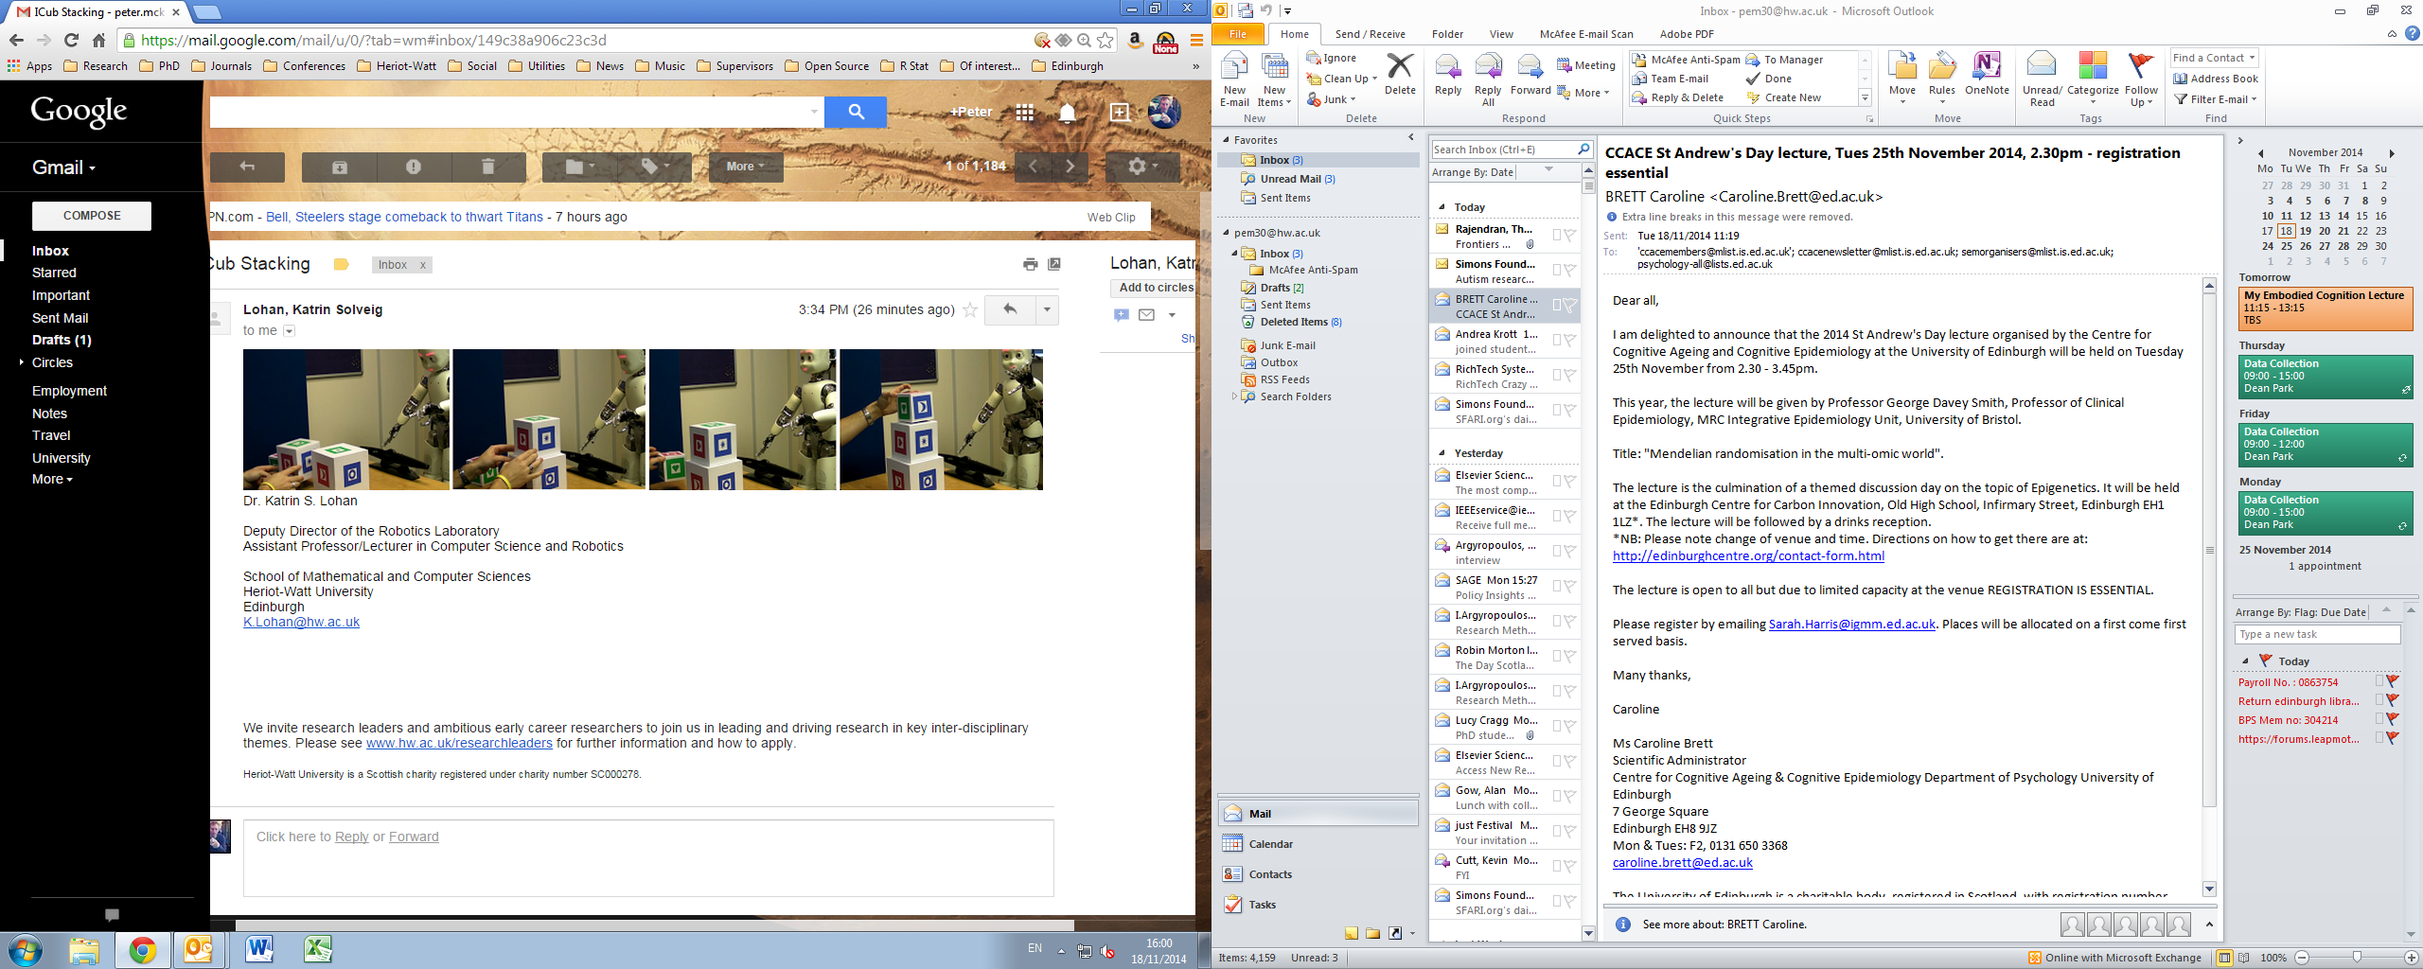
Artificial Intelligence
Symbol processing
Embodied Cognition
IBM’s Deep Blue
iCub robot learning to stack blocks with sensory input
In Heriot-Watt MACS department!

Slide 9

Perception
J.J. Gibson’s Affordance Theory
Gibson (1977) proposed that an organisms perception of the world must be understood in terms of goal of the organism (i.e. their behaviour) and what the environment provides to help attain those goals.
Suggested that the environment is perceived in terms of the potential actions that can be made, so called affordances.
Therefore, Gibson argued that perception and action are inextricably linked; that we think and perceive the world in behavioural terms.
Visual perception: Beer
Affordance: A receptacle holding alcoholic liquid accessible by a pinch grip near the centre followed by lifting and tipping motion

Slide 10
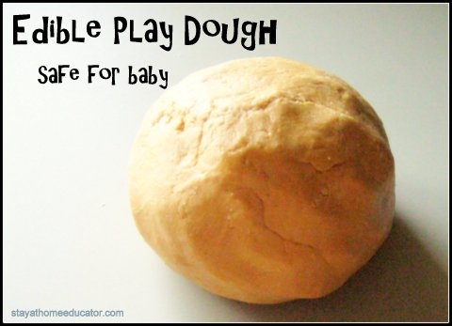
Developmental Psychology
Sensorimotor Stage (0-24 months) (Piaget, 1952):
Without language newborn’s primary tools for understanding the world are their bodies and senses (e.g. taste, smell etc).
Piaget believed that as infants age they adapt a set of inherent reflexes in order to surpass the challenges that their environment throws at them.
For example, infants quickly adapt their sucking rate and mouth shape to receive the optimal amount of milk while being breast-fed.
Also, by testing other objects in their mouths they deduce that it is only the breast during this period that affords them opportunities to feed.
This internalisation of action – outcome contingencies (motor schemas) marks the beginning of representation. Actions dictated by representation do not require perception, but are fully symbolic in nature…the grassroots of cognition.

Slide 11
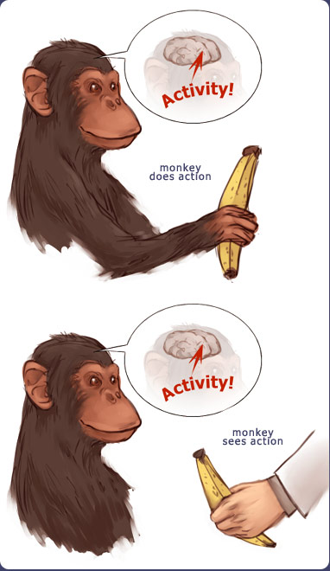
Neuropsychology
Mirror Neuron System (MNS; Rizzolatti et al., 1996):
Premotor neurons activate when an action is executed, and also when it is observed being performed by someone else (Gallese et al., 1996).
Neurobiological analogue of embodied cognition: thinking is acting and vice-versa.
Embodied Simulation enables us to understand the meaning, intention, feeling and emotion underlying other’s behaviour.
Suggests that perception is not a static process, but instead involves our imagining of acting out the actions of others.
“Social identification, empathy, and ‘we-ness’ are the basic ground of our development and being.” (Gallese, 2009).

Slide 12
Summary of Embodied Cognition
Descartes Dualism highlighted the lack of understanding of the mind-body problem…provided impetus for contemporary scientists in the field
Searle’s Chinese Room thought experiment demonstrated that human cognition is not mere symbol manipulation, that the essence of cognition requires physical experience in the world
Gibson’s Affordance theory also demonstrated the complex nature of our cognition/perception, such that we perceive in terms of potential actions made available by the environment
The mirror neuron system proposed by Rizzolatti et al. (1996) suggests a common neural substrate for both action execution and understanding, indicating that the motor system influences our decision making and interpretation of others

Slide 13
Embodiment in Interaction
The following definition, developed by Quick et al., 1999a, Quick et al., 1999b),is defining embodiment as that which establishes a basis for structural coupling by creating the potential for mutual perturbation between system and environment. Embodiment is in this sense not solely a feature of a system in an environment, but is grounded in the relationship between the two.
Definition: A system S is embodied in an environment E if perturbatory channels exist between the two. That is, S is embodied in E if for every time t at which both S and E exist, some subset of E’s possible states with respect to S have the capacity to perturb S’s state, and some subset of S’s possible states with respect to E have the capacity to perturb E’s state.

Slide 14
Embodiment in Interaction
How can we manipulate this embodiment ?
by manipulating the system
the environment
how they interact with each other
a combination of the above
How does it effects the interaction?
let’s find out what happens when we manipulate the system

Slide 15
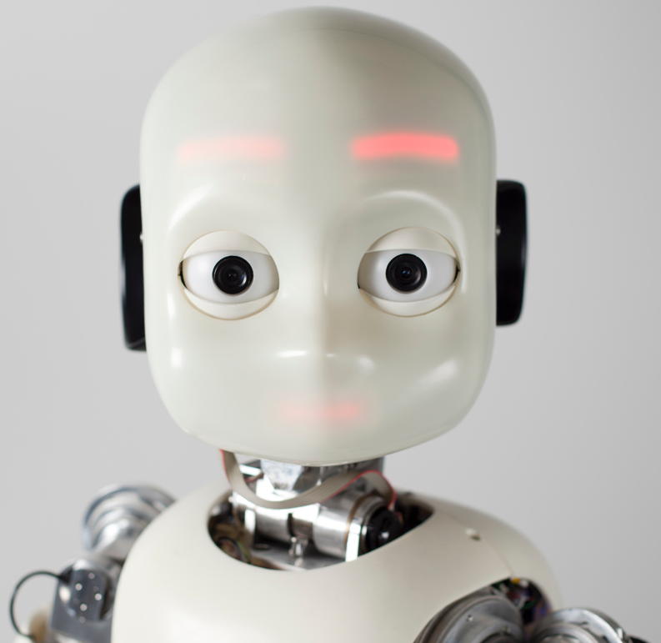
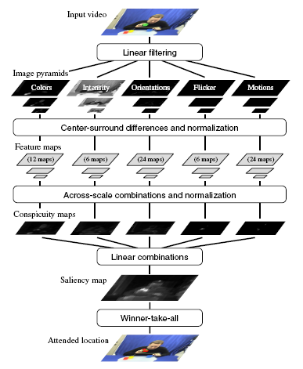
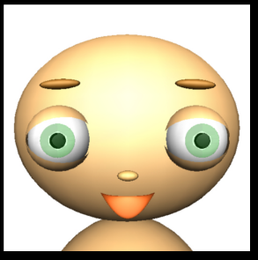

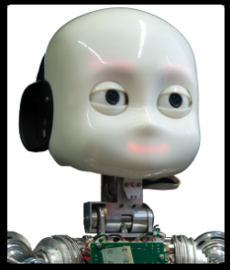
Embodiment in Interaction
an example
14 naive users were interacting with the baby-face
7 naive users were interacting with the iCub (Eyes only condition)
7 naive users were interacting with the iCub (Head condition)
[Lohan et al. 2010]

Slide 16
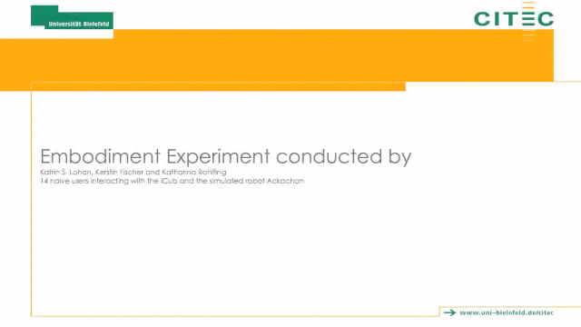
Embodiment Experiment
Notes:
compared iCub eyes only, head and baby-face condition
saliency system

Slide 17
baby-face vs. iCub: embodiment
Contingency :
In the head condition, iCub was gazed at longer and the number of gaze shifts towards the object was higher in this condition.
In the Baby-face condition, we found that during the task, the tutor was looking longer towards the object than in the iCub head condition.
Language:
the language used towards the iCub head condition has the lowest complexity
the robot’s name is uttered most in the iCub head condition
<=
<
[Lohan et al. 2010]
[Fischer, Lohan et al. 2012]
Notes:
embodiments helps to get more contingent gazing behavior
the robot is addressed more, but the complexity of the used language is lower in head then in the other conditions

Slide 18
Summary: Embodiment in Interaction
an example
The degrees of freedom have been manipulated and therefore the system.
The appearance has been manipulated and therefore the embodiment.
Notes:
to summerize
hand trajectories dose not reveal a difference
eye-gazing dose
embodiment helps to support the acceptance of the robot as a social interaction partner
also supported by the language
but the complexity of language is more appropriate less complex?

Slide 19
References
Blom, J.R. (1979). Descartes: His moral philosophy and psychology. New York.
Cook, S.W., & Tanenhaus, M.K. (2009). Embodied communication: Speakers’ gestures affect listeners’ actions. Cognition, 113(1), 98-104.
Diamond, A. (2000). Close interrelation of motor development and cognitive development and of the cerebellum and the prefrontal cortex, Child Development, 71(1), 44-56.
Gallese, V., Fadiga, L., Fogassi, L., & Rizzolatti, G. (1996). Action ecognition in the premotor cortex. Brain, 119, 593–609.
Fischer, K., Lohan, K., & Foth, K. (2012, March). Levels of embodiment: Linguistic analyses of factors influencing hri. In Human-Robot Interaction (HRI), 2012 7th ACM/IEEE International Conference on (pp. 463-470). IEEE.
Lohan, K., Gieselmann, S., Vollmer, A. L., Rohlfing, K. J., & Wrede, B. (2009). Does embodiment affect tutoring behavior. In Proceedings of the IEEE 8th International Conference on Development and Learning.

Slide 20
References cont.
Eigsti, I. (2013). A review of embodiment in autism spectrum disorders. Frontiers in Psychology, 4(224), 1-10.
Grafton, S.T. (2009). Embodied cognition and the simulation of action to understand others. Annals of the New York Academy of Sciences, 1156, 97-117.
Homer, B.D., Kinzer, C.K., Plass, J.L, Letourneau, S.M., Hoffman, D., Boromley, M., Hayward, E.O., Turkay, S., & Kornak, Y. (2014). Moved to learn: The effects of interactivity in a Kinect-based literacy game for beginner readers. Computers in Education, 74, 37-49.
O’Neill, G., & Miller, P.H. (2013). A show of hands: Relations between young children’s gesturing and executive functioning. Developmental Psychology, 49(8), 1517-1528.
Quick, T., Dautenhahn, K., Nehaniv, C. L., & Roberts, G. (1999). On bots and bacteria: Ontology independent embodiment. In Advances in Artificial Life (pp. 339-343). Springer Berlin Heidelberg.
Quick, T., Dautenhahn, K., Nehaniv, C., & Roberts, G. (2000, May). The essence of embodiment: A framework for understanding and exploiting structural coupling between system and environment. In AIP conference proceedings (pp. 649-660). IOP INSTITUTE OF PHYSICS PUBLISHING LTD.

